Slide 1


Education in America
18April20
Jennifer Borgogno
Cheryl Hornung
Elizabeth Overman
John Wittenborn

Slide 2
Education in America
What are major characteristics of education by state and demographics in the US?
What is the geographic variation of educational attainment?
What is the association between educational attainment and income?

Slide 3
Data Sources
US Census
American Community Survey API
Education data by state & county
Income data by state & county
Google Maps API
State-level heatmapping of education data
Population data by state

Slide 4
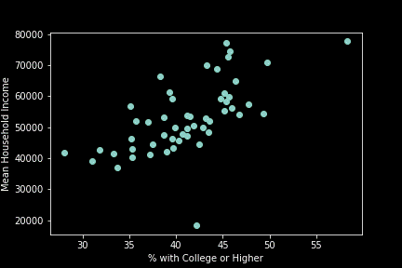
Association of Education and Income
‘Education’ = bachelors degree + post graduate degree
Clear correlation between ‘Education’ and income at the state level
Possible outliers

Slide 5
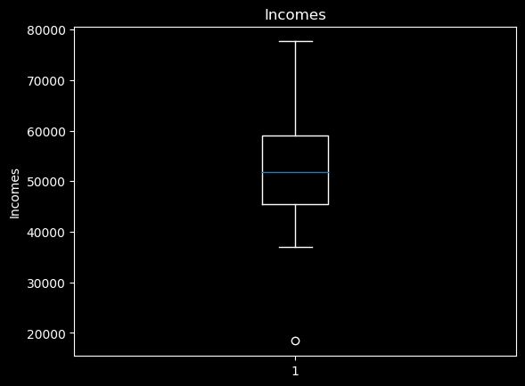
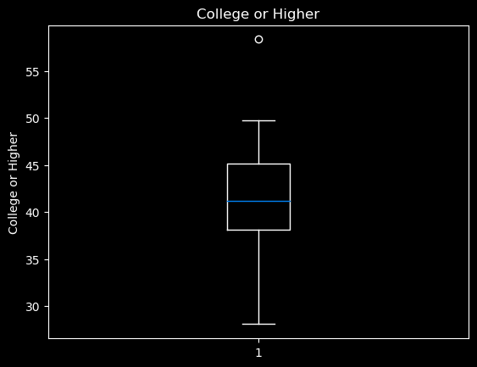
Removing Outliers
Washington DC
Puerto Rico

Slide 6
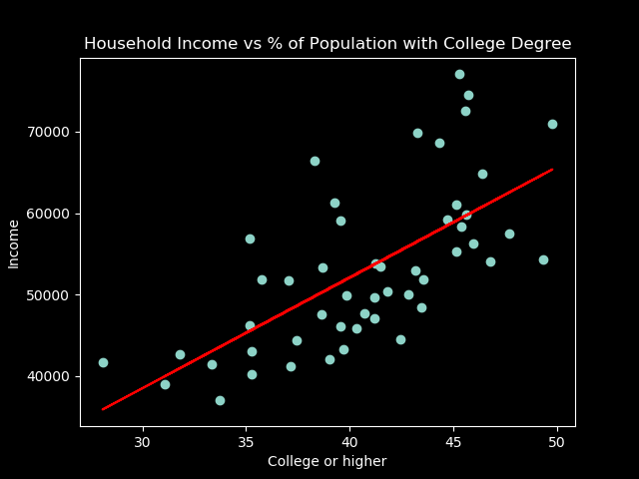
Higher education populations associated with higher income
10% increase in prevalence of college+ education is associated with a $13,584 increase in mean household income.

Slide 7
Cheryl
Google API overview

Slide 8
Cheryl
Heat map

